Slide 1
Modeling Gamma Source Detection and Localization through Materials
Darrell Stepter¹
Kai Vetter^{1,2}
¹University of California, Berkeley
Department of Nuclear Engineering
²Lawrence Berkeley National Laboratory
Applied Nuclear Physics – Nuclear Science Division
Masters Presentation
May 2019

Slide 2
PRESENTATION OUTLINE:
Motivation
Methodology
Search Scenario
Model Development
Model Verification
Simulation Results
Localization
Conclusions
Future Work

Slide 3
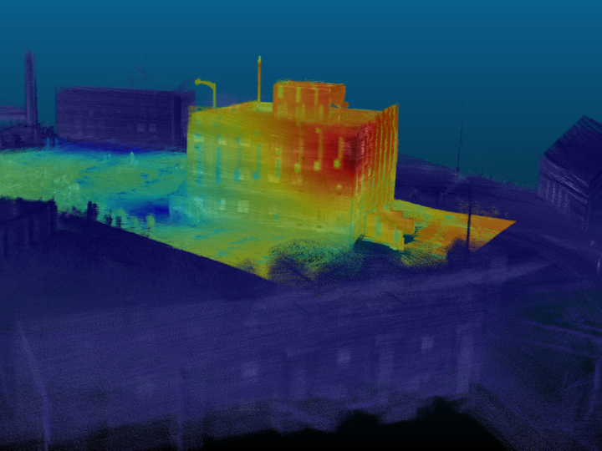
MOTIVATION: Gamma “Heat Map” produced by LAMP on drone
Unmanned Search Technology Demonstration at Camp Roberts
Unknowns:
Source
Source Activity
Source Location
Building Geometry
Building Materials
This image generated three questions?
Can we quantify the flux?
Can we differentiate between transmitted and scattered gammas?
Can we use this information to calculate Source Location?
Notes:
This image shows a comparative flux, but no actual rates or energies. This is helpful for localization, but more information on can help source identification, which can inform things such as exposure time for responders and recovery equipment required

Slide 4
METHODOLOGY: Model and Validate in a Controlled Scenario
Model:
Build model eliminating unknowns (Source, Activity, Location, Geometry, and Materials)
Run simulation to calculate instantaneous flux at detector.
Back Project instantaneous flux at detector to surface flux
Answers Question #1 - Quantification
Segregate simulation results (i.e. by energy or last location) and compare results to examine gamma transmission and scattering
Answers Question #2
Validation:
Mathematically validate model using known flux/count-rate equations
Notes:
Back projection is a misnomer in this case.
Quantification is a misnomer

Slide 5
SEARCH SCENARIO: National Planning Scenario 11 – Radiological Attack
The Federal interagency community has developed 15 all-hazards National Planning Scenarios for use in national, Federal, State, and local homeland security preparedness activities. The Scenarios are planning tools and are representative of the range of potential terrorist attacks and natural disasters and the related impacts that face our nation. The objective was to develop a minimum number of credible scenarios in order to establish the range of response requirements to facilitate preparedness planning.
In Scenario 11, the Universal Adversary (UA) purchases a stolen Cobalt-60 (⁶⁰Co) Teletherapy source to make a Radiological Dispersal Device (RDD), or “dirty bomb.” The explosive and source are smuggled into the country. Detonator cord is stolen from a mining operation, and all other materials are obtained legally in the United States.
An activity about 444 TBq (12,000 Ci) is loaded initially in these machines. The ⁶⁰Co source decays at a rate of about 1% per month. Therefore, the mean activity encountered in these machines at any point of time range between 185–333 TBq (5000–9000 Ci).
*DHS National Planning Scenarios, March 2006
Notes:
Cobalt teletherapy machines have an edge over the linear accelerators because of less maintenance costs, less infrastructure requirements, low power demands, and simple quality assurance of the beam parameters.

Slide 6
SEARCH SCENARIO: Search Hierarchy
The Military normally conducts radiological search and recovery in four areas:
Beyond Line of Sight (BLOS) – satellite and high altitude reconnaissance systems
Far Area – fast moving airborne systems
Near Area – ground vehicle, helicopter, and Unmanned Aerial Systems (UAS)
Objective Area – Unmanned Ground Systems (UGS) and dismounted personnel
* Advances in UAS mounted detection will allow for the collection of information in the Near Area that once could only be collected in the Objective Area. These advances and additional ones in UGS will minimize personnel exposure in Objective Area.
Notes:
Beyond Line of Sight (BLOS) – Air Force
Far Area – Air Force
Near Area – just outside the effects range of hazard
Objective Area – within the effects range of hazard

Slide 7
MODEL DEVELOPEMENT: Tools
Medium-Energy Gamma-ray Astronomy library (MEGAlib)
Geometry for MEGAlib (Geomega) is MEGAlib's universal geometry and detector library. The geometry itself is described in a .geo file, which describes the volume tree, the materials, the detectors, the trigger criteria, etc.
The Cosmic simulator (Cosima) is MEGAlib's Geant4 based simulator. It utilizes the geometry and detector information from Geomega and source information file to perform the simulations.
The output sim file contains information on every gamma produced (9 million) and every interaction from generation to contact/escaping volume.
* A. Zoglauer et al., Cosima - The cosmic simulator of MEGAlib, NSS Conference record, 2009
Notes:
Not trivial - Sim files are ~20 GB – have to write a script to strip applicable data [hit location, last interaction, energy, time] and write to NumPy array. ~90 MB

Slide 8
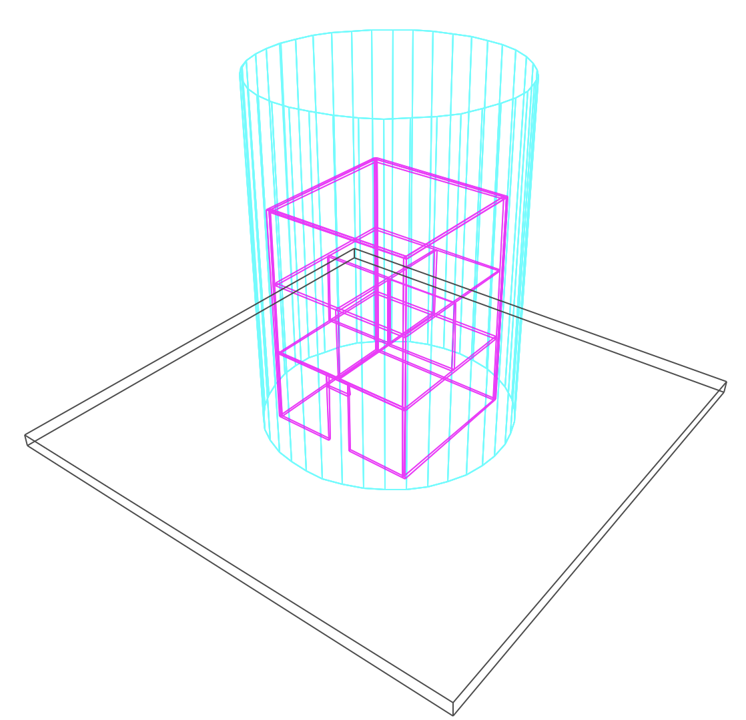
MODEL DEVELOPMENT: Concrete Building on Asphalt Surface
Pros:
Known Geometry
Known Materials
Easily Replicated in real world
Cons:
Simple Geometry does not fully reflect real world
Building is 9m tall with 6m length walls. First floor has open entry way. Second floor is divided into four rooms. “Detector” is 14m tall ideal blackbody absorber (100% efficiency) with 5m radius. Source is modeled as point source.
Notes:
This approximates a UAS mounted detector system, with pre-plotted GPS coordinates, moving at a fixed radius around a building. Approach is detector agnostic, BB abo

Slide 9
MODEL DEVELOPEMENT: Materials
Concrete, Ordinary (NIST)
Density: 2.3 g/cm³
Weight Fractions:
H 0.022100
C 0.002484
O 0.574930
Na 0.015208
Mg 0.001266
Al 0.019953
Si 0.304627
K 0.010045
Ca 0.042951
Fe 0.006435
Asphalt Pavement
Density: 2.5784 g/cm³
Weight Fractions:
H 0.007781
C 0.076175
N 0.000363
O 0.459103
Na 0.011659
Mg 0.021757
Al 0.051009
Si 0.231474
S 0.002804
K 0.017058
Ca 0.084471
Ti 0.003403
V 0.000024
Mn 0.000362
Fe 0.031375
Ni 0.000002
Pb 0.001179

Slide 10
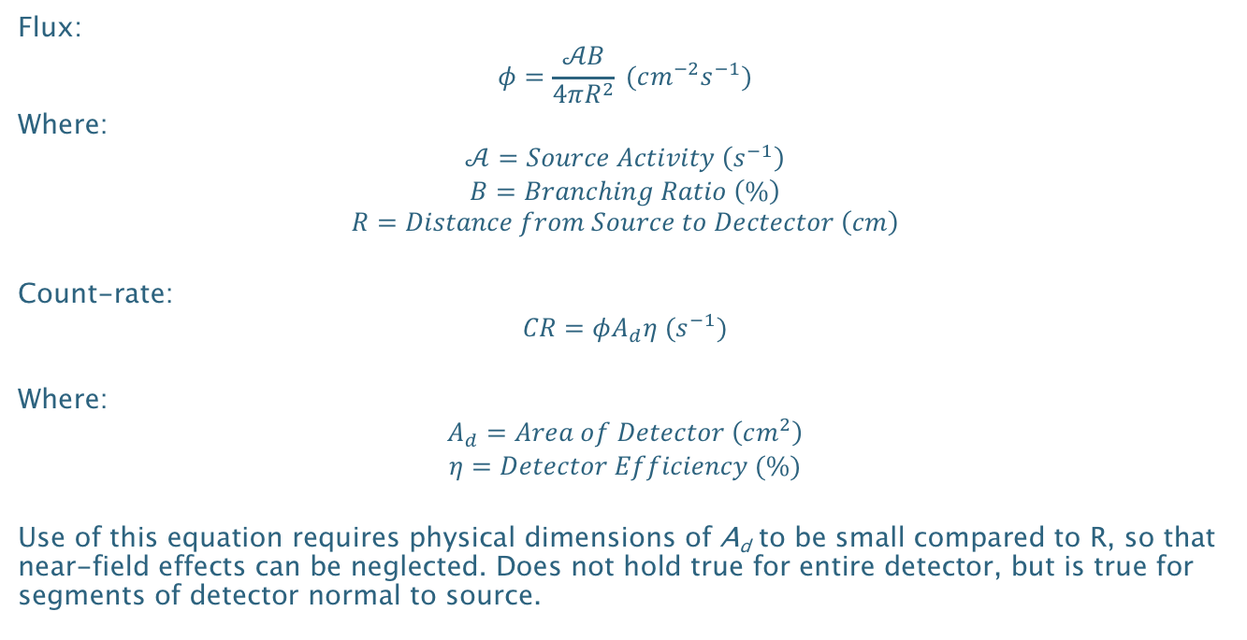
MODEL VALIDATION: Mathematical Flux and Count-rate Calculations
Flux:
$$φ=\frac{𝒜B}{4πR^{2}} (cm^{−2}s^{−1})$$
Where:
$$𝒜=Source Activity \left(s^{−1}\right)$$
$$B=Branching Ratio \left(\%\right)$$
$$R=Distance from Source to Dectector \left(cm\right)$$
Count-rate:
$$CR=φA_{d}η (s^{−1})$$
Where:
$$A_{d}=Area of Detector \left(cm^{2}\right)$$
$$η=Detector Efficiency (\%)$$
Use of this equation requires physical dimensions of A_{d} to be small compared to R, so that near-field effects can be neglected. Does not hold true for entire detector, but is true for segments of detector normal to source.
*Morse, Analytical Methods for Nonproliferation, pg. 24
Notes:
Flux equation is an approximation with particles traveling in 4𝜋 space and the area of the transit area as 4𝜋R². However, in reality, the area at R is a square on a spherical surface and the actual area is $A=R^{2}\int_{φ_{1}}^{φ_{2}}{\int_{θ_{1}}^{θ_{2}}{\sin{θ}dθ dφ}}$

Slide 11
MODEL VALIDATION: Mathematical Flux and Count-rate Calculations
Simulating ⁶⁰Co source producing 3 million gammas, 100% Branching Ratio for 1.332 MeV Gamma, 7.5 m distance, and 40cm * 3° (1570.8 cm²) Detector Area, and 100% efficiency.
Expected: 666.66 Expected Counts
Calculated: 668.21 Mean Counts, 24.87 St. Dev.
Notes:
Explain how model works
Run Sim
Parse by hits
Convert Cartesian to Cylindrical
Histogram Response

Slide 12
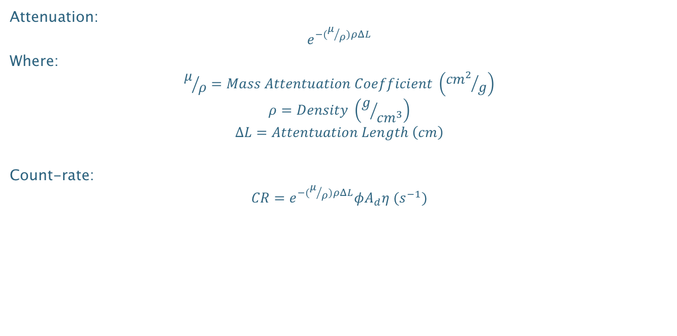
MODEL VALIDATION: Mathematical Flux and Count-rate Calculations with Attenuation
Attenuation:
$$e^{−(μ/ρ)ρΔL}$$
Where:
$$μ/ρ=Mass Attentuation Coefficient \left({{cm}^{2}}/g\right)$$
$$ρ=Density \left(g/{{cm}^{3}}\right)$$
$$∆L=Attentuation Length \left(cm\right)$$
Count-rate:
$$CR=e^{−(μ/ρ)ρΔL}φA_{d}η (s^{−1})$$

Slide 13
MODEL VALIDATION: Mathematical Flux and Count-rate Calculations with Attenuation
0.062 Mass Attenuation Coefficient, 2.3 g/cm3 Density, and 10 cm Attenuation Length.
Expected: 60.998 Expected Counts
Calculated: 61.06 Mean Counts, 7.30 St. Dev.
*Mass Attenuation Coefficient for Concrete, Ordinary (NIST) from https://physics.nist.gov/PhysRefData/Xcom/html/xcom1.html

Slide 14
GEOMEGA MODEL: Segregating Simulation Data – Based off Energy and Last Location
Full Energy Deposition
Partial Energy Deposition – Concrete Scattered
Partial Energy Deposition – Asphalt Scattered
Notes:
Explain what don’t see – double attenuation

Slide 15
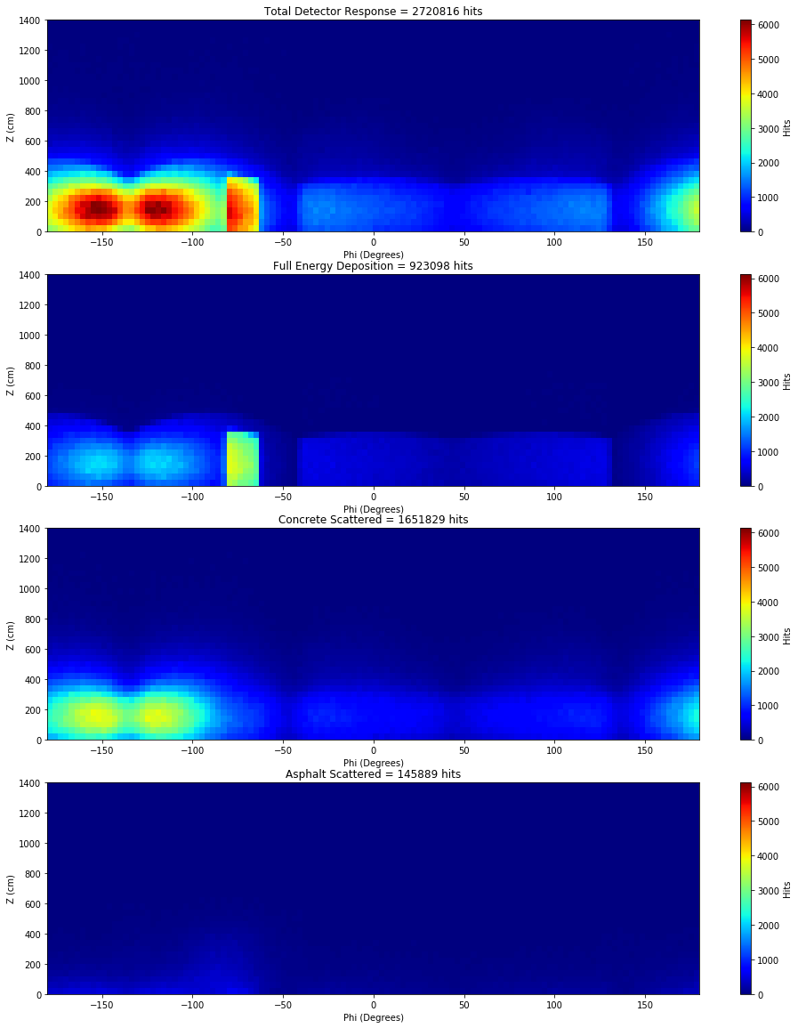
SIMULATON RESULTS:
⁶⁰Co Source
Located on 1st Floor in SW of room
9 Million 1.332 MeV Particles Generated
Notes:
Each pixel is 40 cm x 3º (1047 cm²)

Slide 16
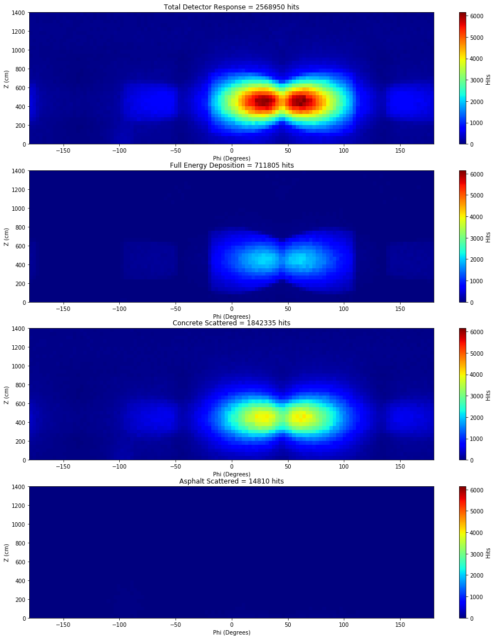
SIMULATON RESULTS:
⁶⁰Co Source
Located on 2nd Floor in center of NE room
9 Million 1.332 MeV Particles Generated
Notes:
Each pixel is 40 cm x 3º (1047 cm²)

Slide 17
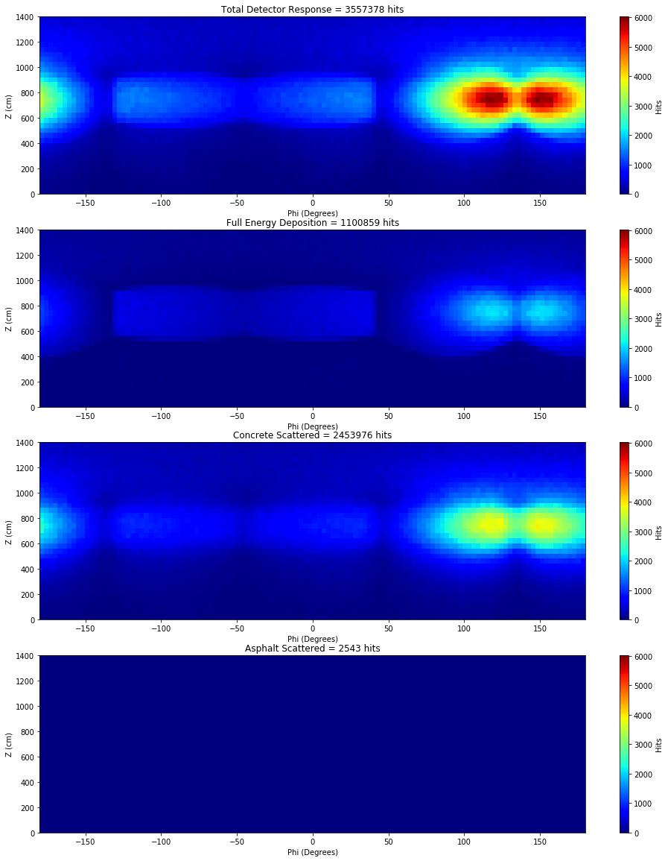
SIMULATON RESULTS:
⁶⁰Co Source
Located on 3rd Floor in NW of room
9 Million 1.332 MeV Particles Generated
Notes:
Each pixel is 40 cm x 3º (1047 cm²)

Slide 18
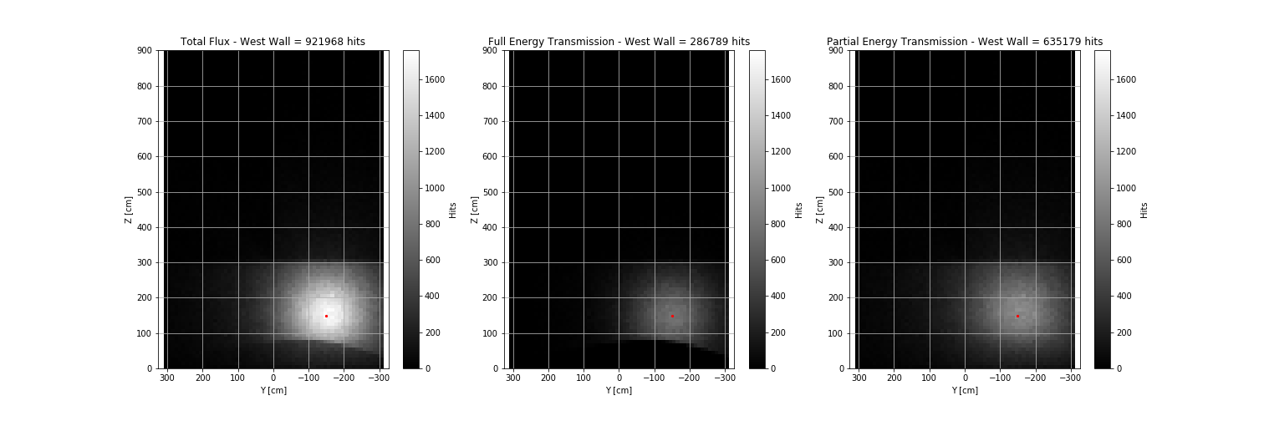
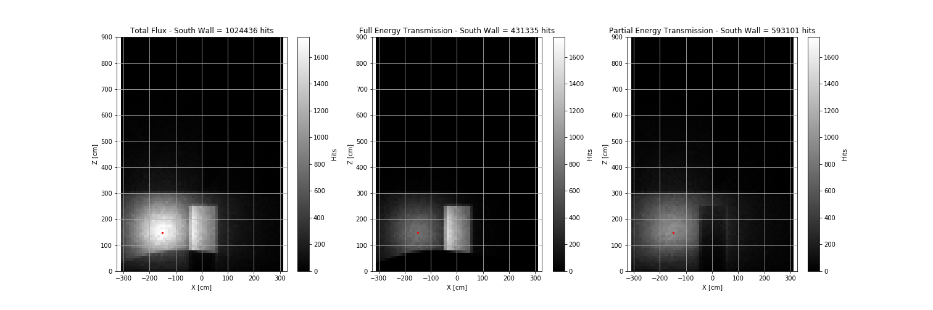
SIMULATON RESULTS: Back Projected Flux at Building Surface
Notes:
60Co Source
Located on 1st Floor in SW of room
9 Million 1.332 MeV Particles Generated

Slide 19
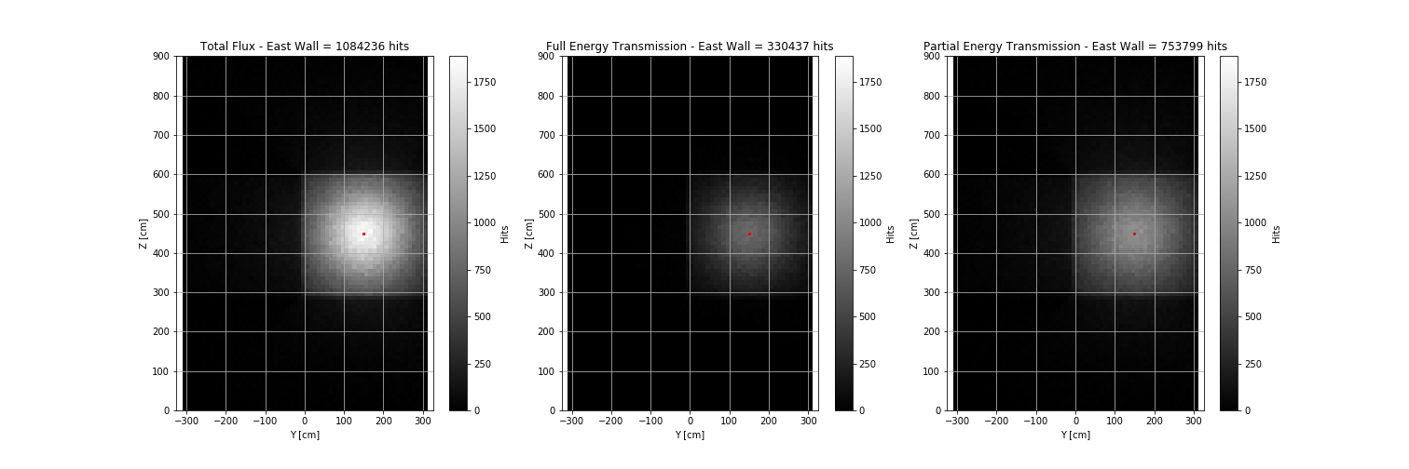
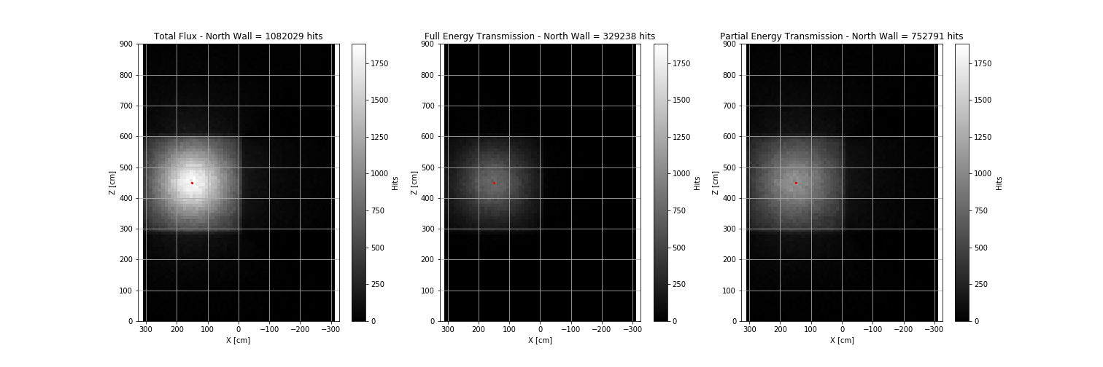
SIMULATON RESULTS: Back Projected Flux at Building Surface
Notes:
60Co Source
Located on 2 Floor in SW of room
9 Million 1.332 MeV Particles Generated

Slide 20
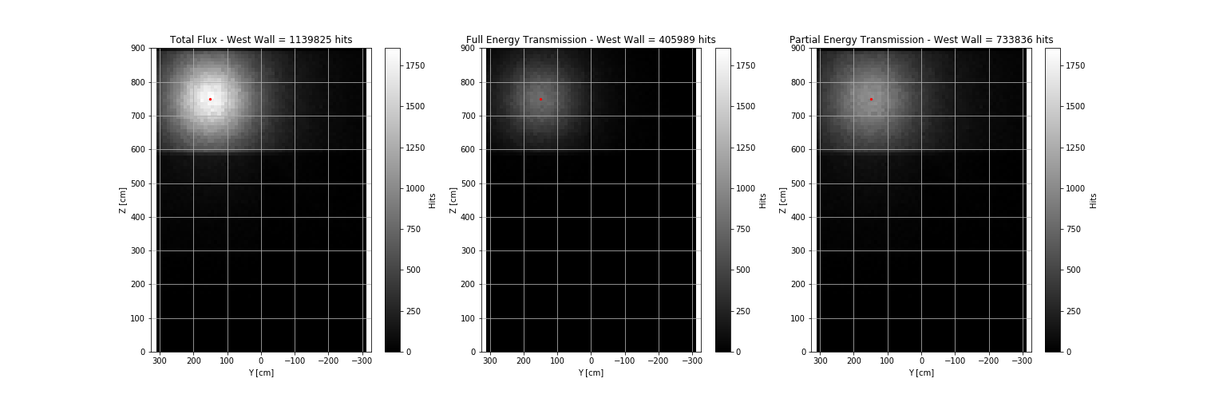
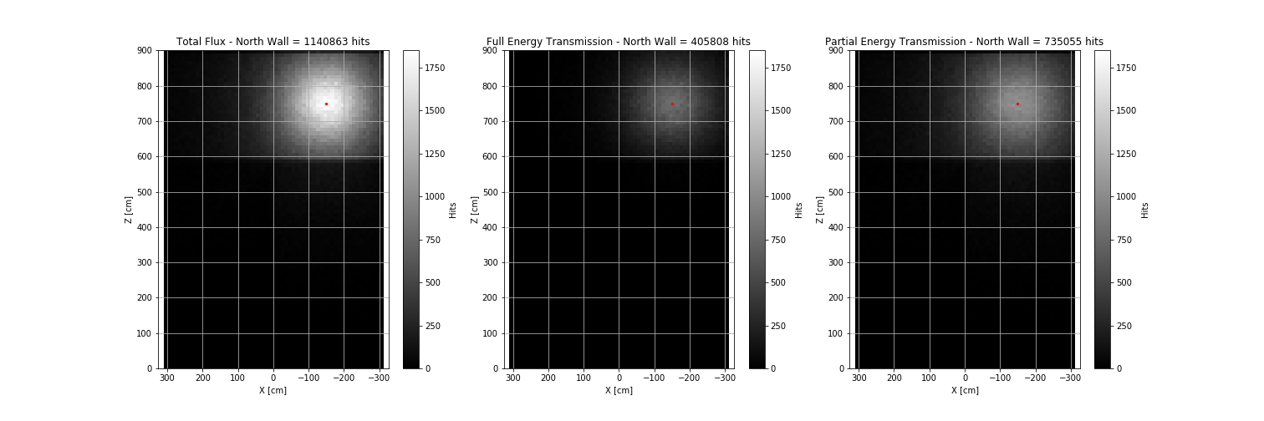
SIMULATON RESULTS: Back Projected Flux at Building Surface
Notes:
60Co Source
Located on 1st Floor in SW of room
9 Million 1.332 MeV Particles Generated

Slide 21
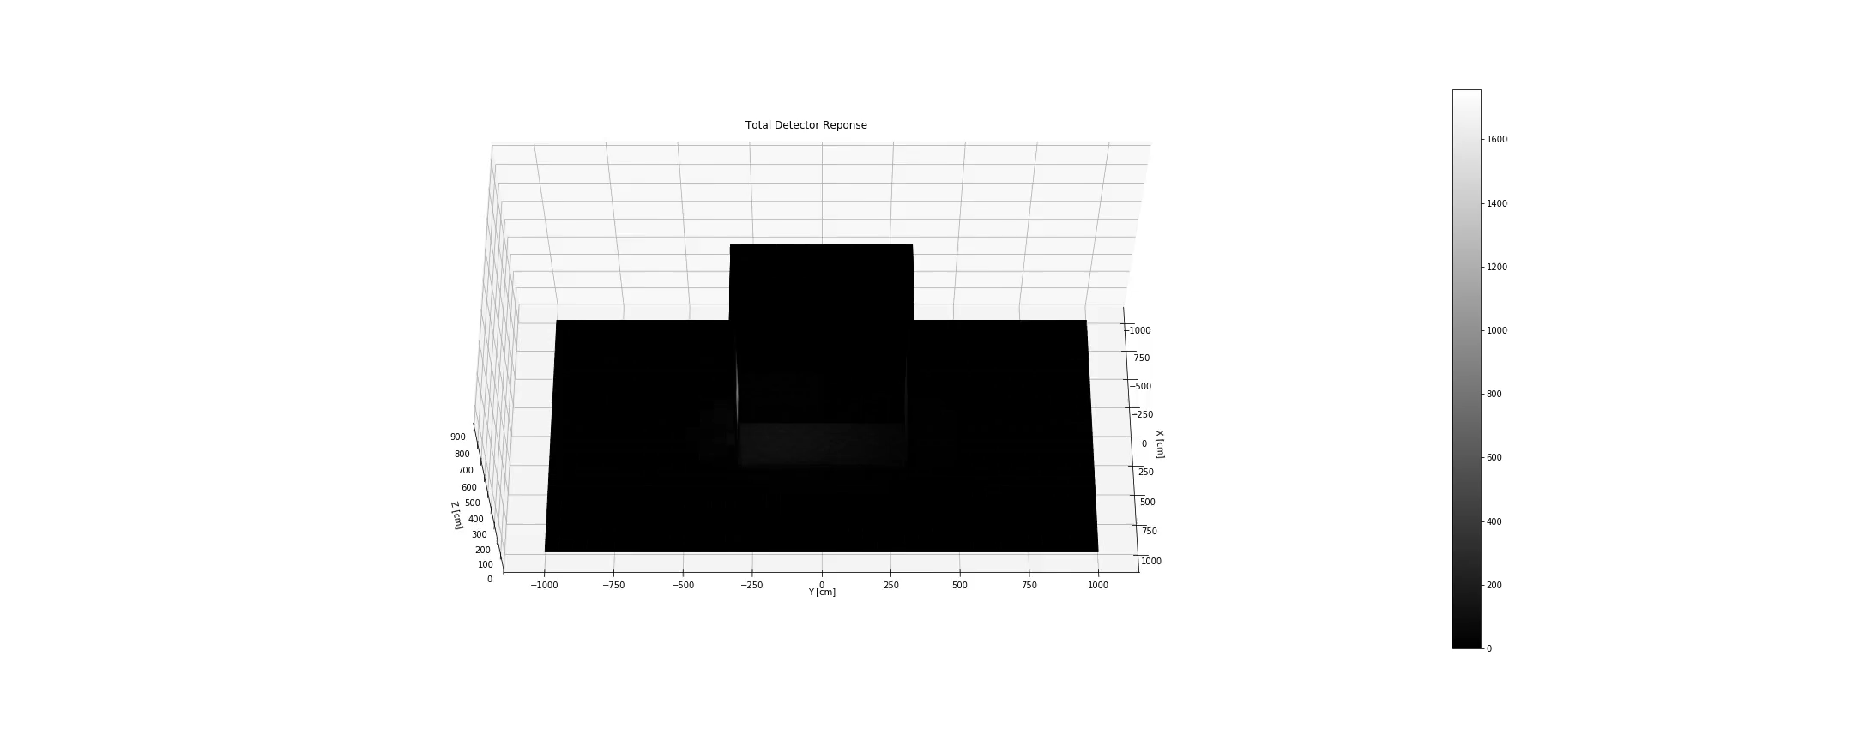
SIMULATON RESULTS: 3D Flux

Slide 22

SIMULATON RESULTS: 3D Flux

Slide 23

SIMULATON RESULTS: 3D Flux

Slide 24
LOCALIZATION: Canny Edge Finder and Random Sample Consensus (RANSAC) fit
Canny Edge Finder:
Apply Gaussian Filter to remove noise from image
Compute the intensity of the gradients
Thin edges to 1-pixel be removing non-maximum pixels of the gradient
Suppress weak edges
RANSAC fit :
Select a random subset of the original data. Call this subset the hypothetical inliers.
A model is fitted to the set of hypothetical inliers.
All other data are then tested against the fitted model. Those points that fit the estimated model well are considered as part of the consensus set.
Re-estimate model using all members of the consensus set.
*John Canny, A Computational Approach to Edge Detection
*Martin Fischler & Robert Bolles, Random Sample Consensus: A Paradigm for Model Fitting with Applications to Image Analysis and Automated Cartography

Slide 25
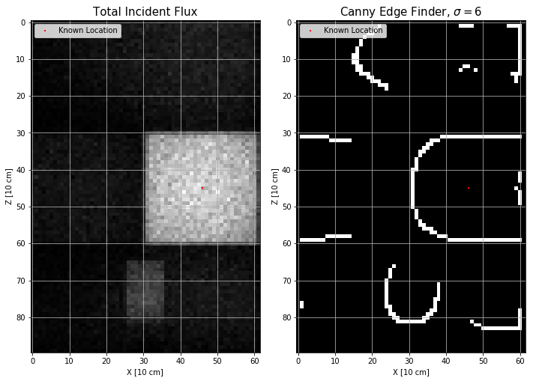
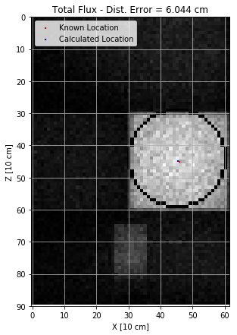
LOCALIZATION: Canny Edge Finder and RANSAC fit
⁶⁰Co Source Located on 2nd Floor in NE of BLDG
Viewing from South
Notes:
Explain features

Slide 26
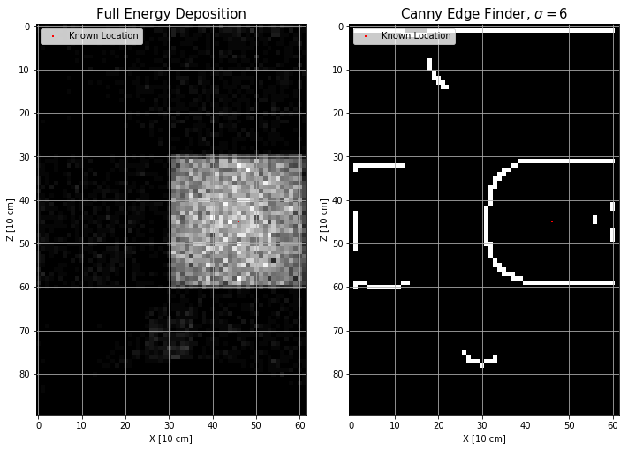
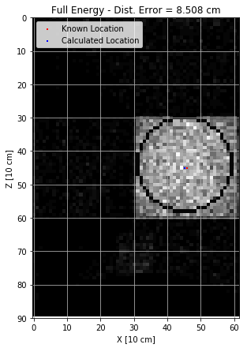
LOCALIZATION: Canny Edge Finder and RANSAC fit
⁶⁰Co Source Located on 2nd Floor in NE of BLDG
Viewing from South
Notes:
Explain features

Slide 27
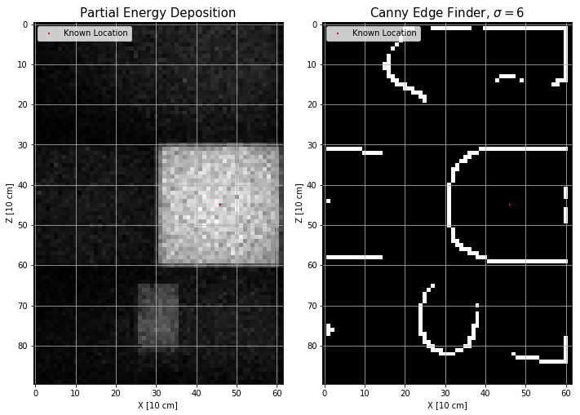
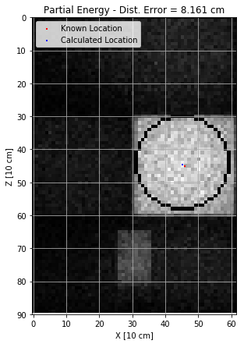
LOCALIZATION: Canny Edge Finder and RANSAC fit
⁶⁰Co Source Located on 2nd Floor in NE of BLDG
Viewing from South
Notes:
Explain features

Slide 28
LOCALIZATION: Linear Error
Detector Response | Distance Between Segments | Distance From Source Location
Total Response | 1.832 cm | 4.966 cm
Full Energy | 0.066 cm | 4.710 cm
Partial Energy | 1.475 cm | 4.510 cm
Notes:
Explain features

Slide 29
CONCLUSIONS:
Produced Incident Flux at detector location and back projected to visualize quantified energy transmission through material surface
Demonstrated accurate (~ 5 cm) source localization external to building
FUTURE WORK:
Introduce “real” detector characteristics and positional uncertainty
Use lower activity/energy source (¹³⁷Cs) and introduce background radiation
Use geometry and materials of a known structure and compare results with current systems
Notes:
Future work should focus on feasibility in a real world environment. Scan speed for LAMP is 3 m/s. That would take ~ 24.5 minutes to scan in this manner. Source Activity is high enough to achieve these results but a lower activity/energy source would produce gammas at a much lower rate and less would be strong enough to penetrate the material. Time of collection if drastically increased could probability of adversary detonation.

Slide 30
Questions?

